Slide 1

What’s New with .NET MAUI
Maddy Leger| Program Manager | Microsoft
@maddyleger1 | maddy@microsoft.com
DotNet 2021 | theurlist.com/maui-dotnetspain

Slide 2
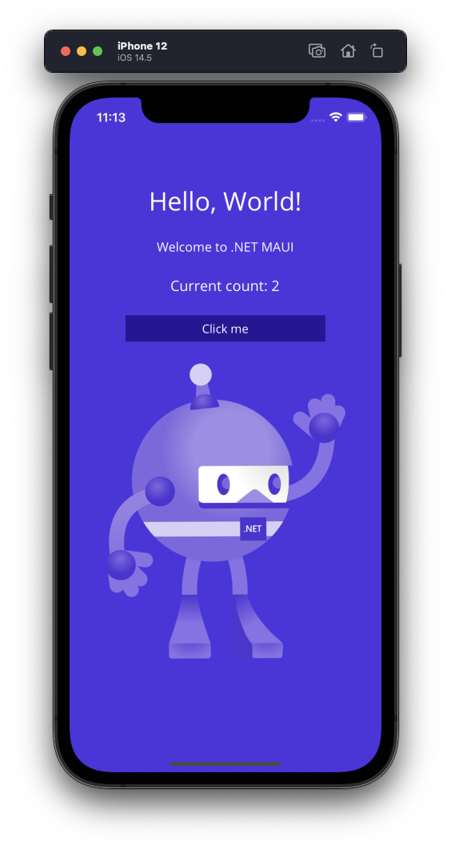
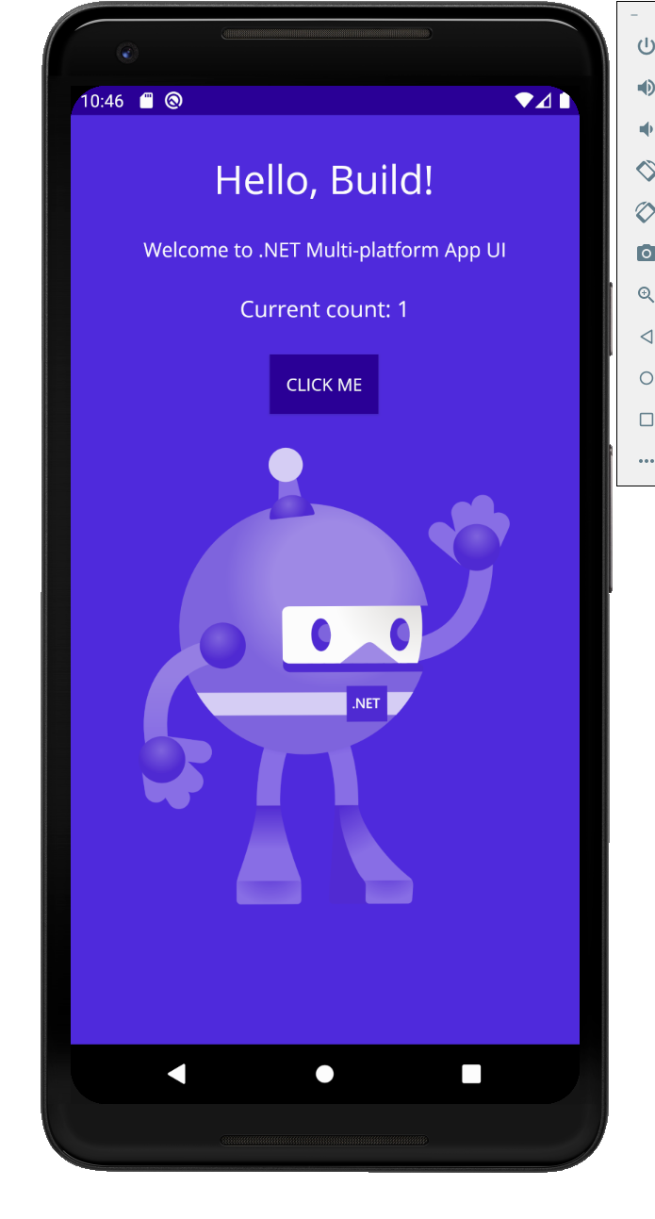
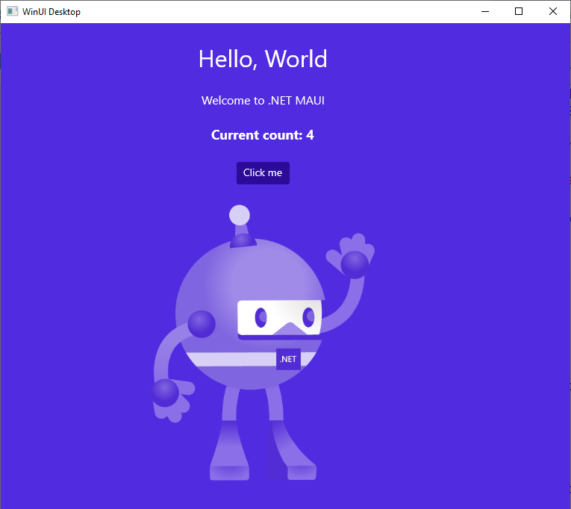
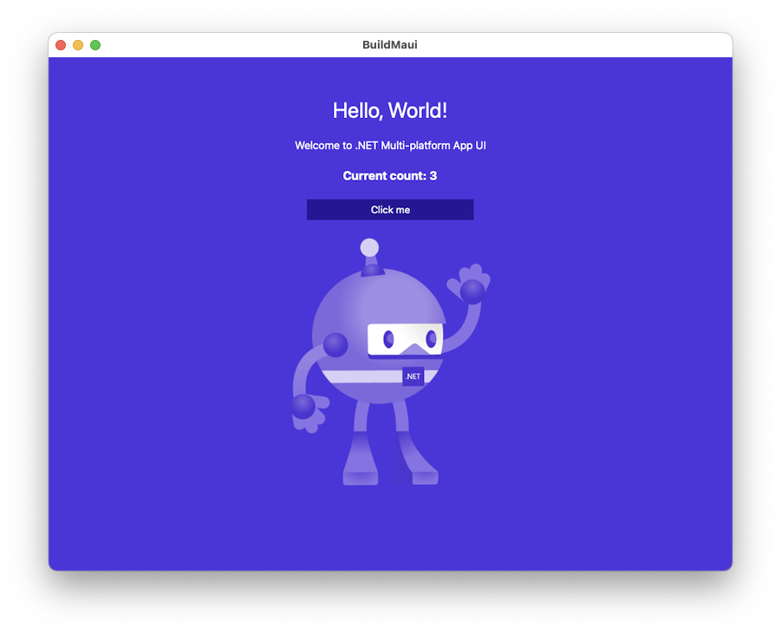
.NET MAUI is the most productive way to develop native apps that perform great on Android, iOS, macOS, or Windows, all from a single codebase.

Slide 3




.NET Multi-platform App UI
.NET 6
Cross-platform, native UI
Single project system, single codebase
Deploy to multiple devices, mobile & desktop
General availability in .NET 6
.NET MAUI
WinUI
Mac Catalyst
iOS
Android
macOS
iOS
github.com/dotnet/maui

Slide 4




Productive
Hot Reloading for XAML, C#, Razor, CSS, and more
Develop for iOS and Android from Windows
Powerful Intellisense and code editing tools

Slide 5
Performant
Rearchitected handlers for faster layout rendering
Faster app startup
Better profiling tools

Slide 6
Single Codebase
Single .NET 6 project holds code for all platforms
Images, Fonts, Raw assets, etc. all shared
Single application point of entry
Simplified binding of native libs for app devs

Slide 7
.NET MAUI is the evolution of Xamarin.Forms extended from mobile to desktop scenarios with UI controls rebuilt from the ground up for performance and extensibility.

Slide 8


.NET
Your platform for building anything
Desktop
Web
Cloud
Mobile
Gaming
IoT
AI

Slide 9
Blazor hybrid desktop apps
Blazor
Reuse UI components across native and web
Built on top of .NET Multi-platform App UI
Native app container & embedded controls
General availability in .NET 6
Can use native app
container & controls
.NET Multi-platform App UI
macOS

Slide 10
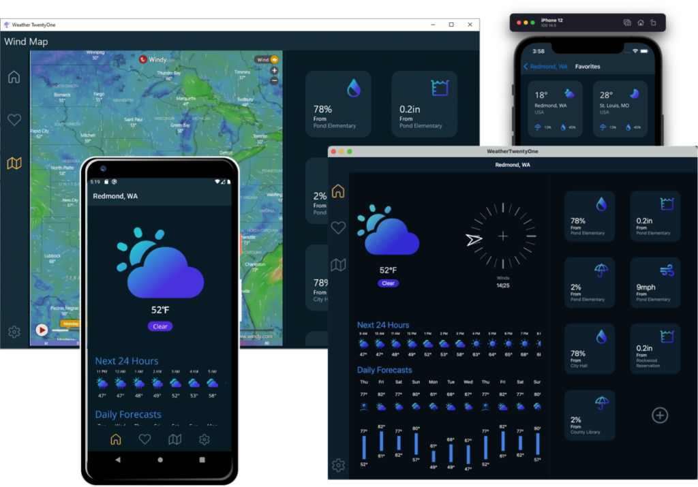
.NET 6 Preview 4

Slide 11
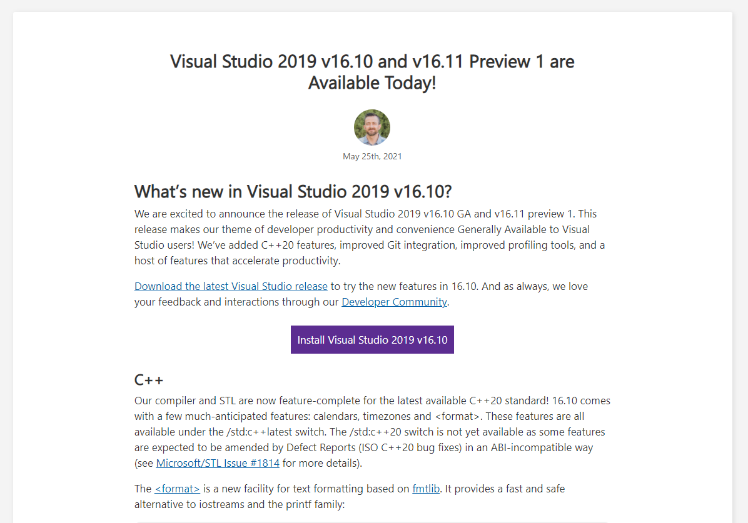
Visual Studio 2019 v16.11 preview

Slide 12
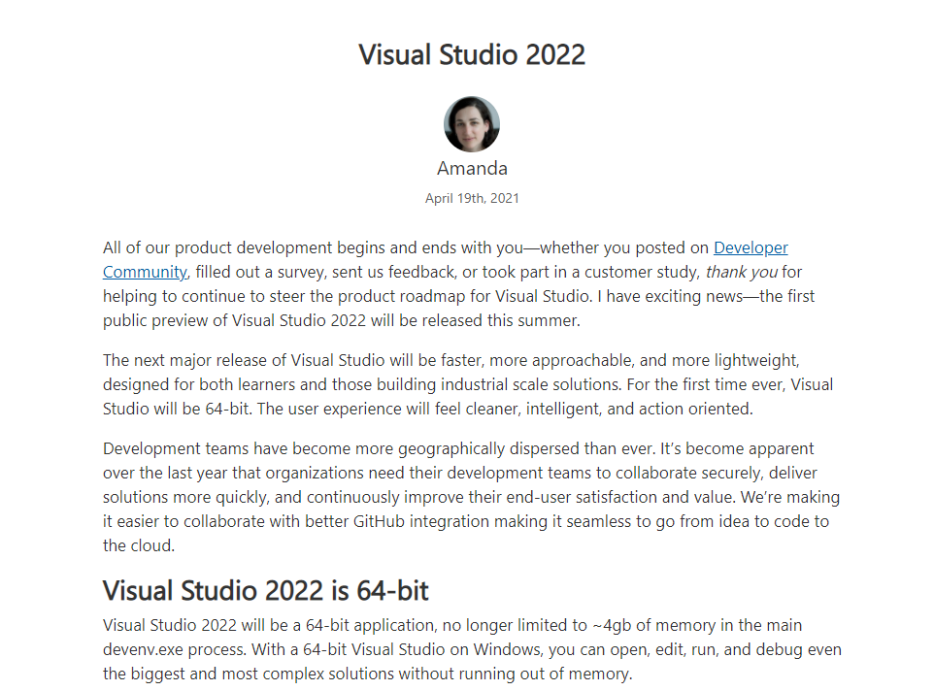
Visual Studio 2022 Previews coming soon!

Slide 13
Demo: .NET MAUI
github.com/dotnet/maui-samples

Slide 14
Coming EVERYWHERE in Preview 5→6
Brushes
Shapes
Clipping
Borders
Corners
Shadows

Slide 15
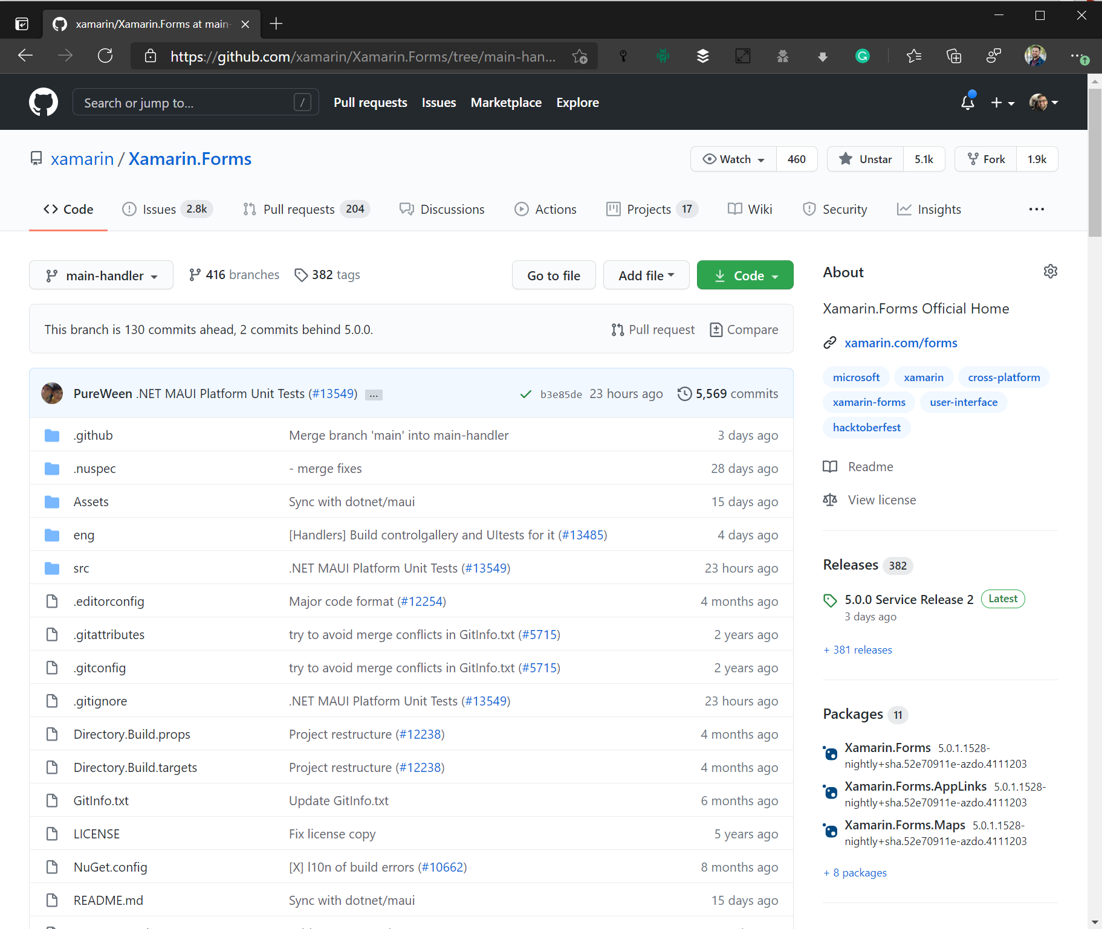
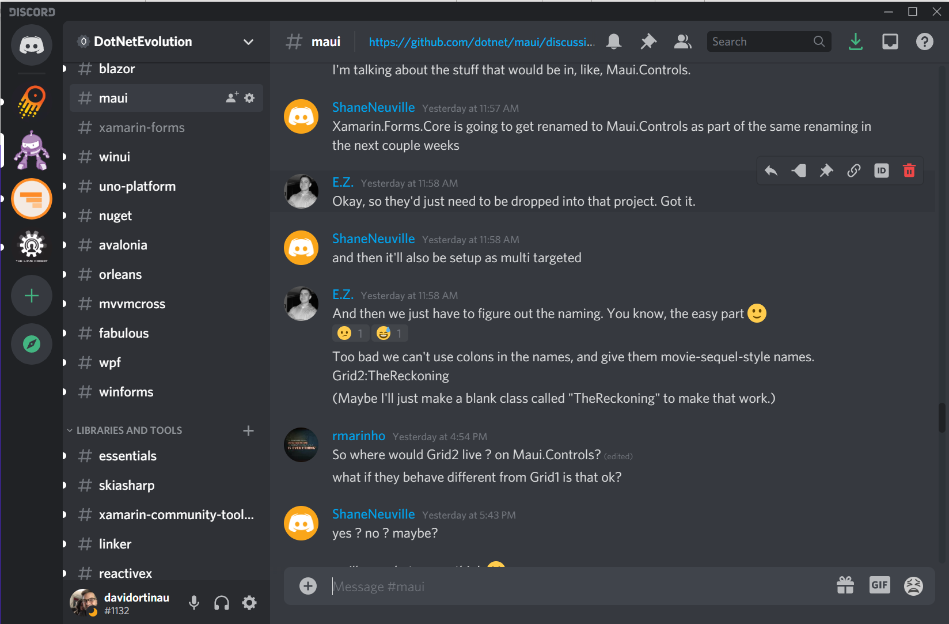
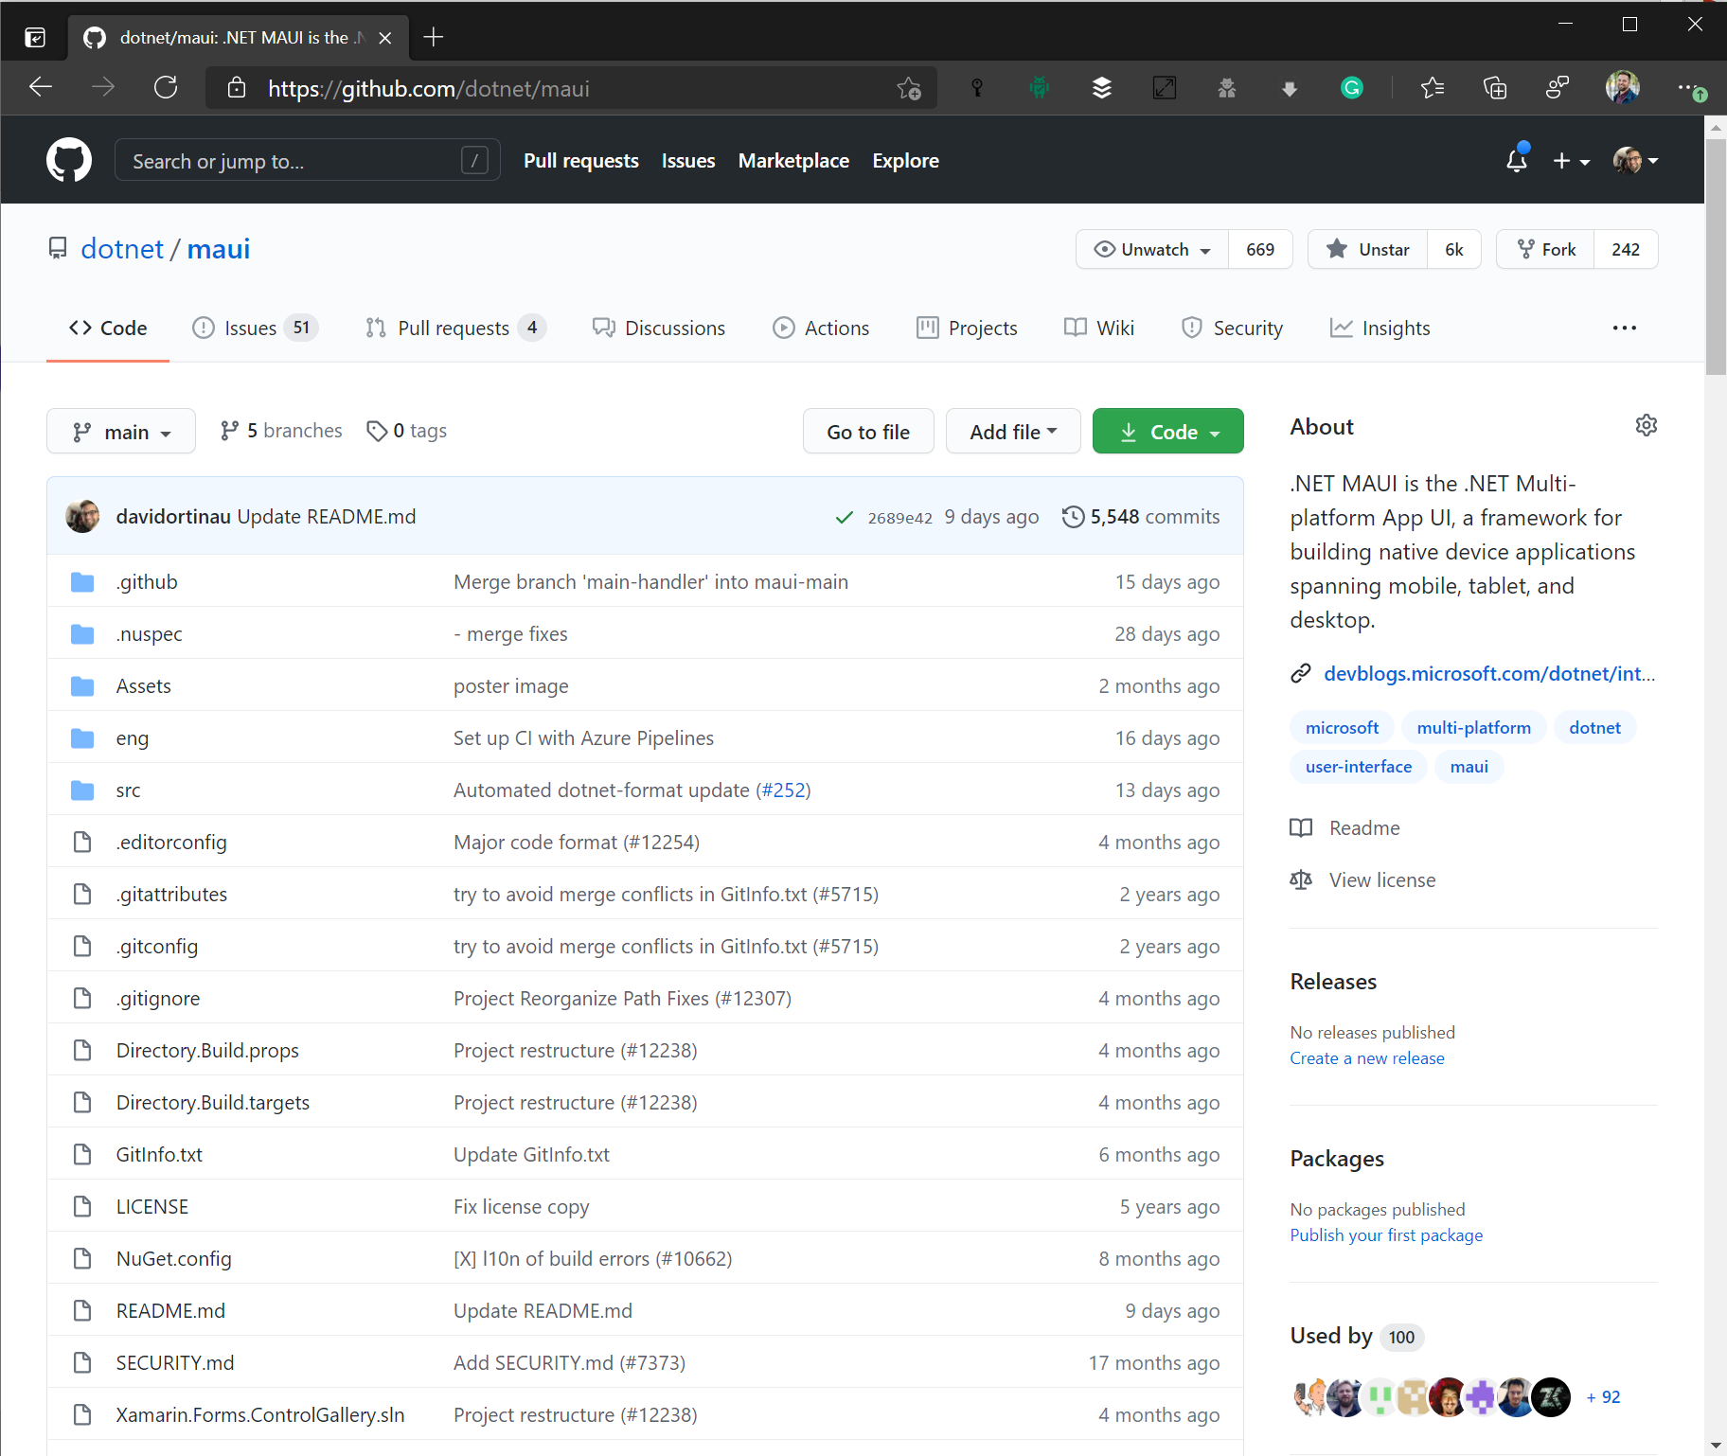
Where is this happening?
https://aka.ms/discord-maui
https://github.com/dotnet/maui

Slide 16

.NET Community Standup
https://live.dot.net
1st Thursday of the Month @ Noon PT / 3 ET
Community News
Contributions
.NET MAUI Status Report
Shenanigans!

Slide 17
OSS Library Maintainer - Monthly Sync
1st Tuesday of the Month @ Noon PT / 3 ET
Teams Call to deep dive on architecture and ask ?s
Current representation from:
FreshMvvm
Mobile Build Tools
MvvmCross
Prism
ReactiveUI
Shiny
Xamarin Community Toolkit
Uno Platform
To join:
📧 david.ortinau@microsoft.com

Slide 18
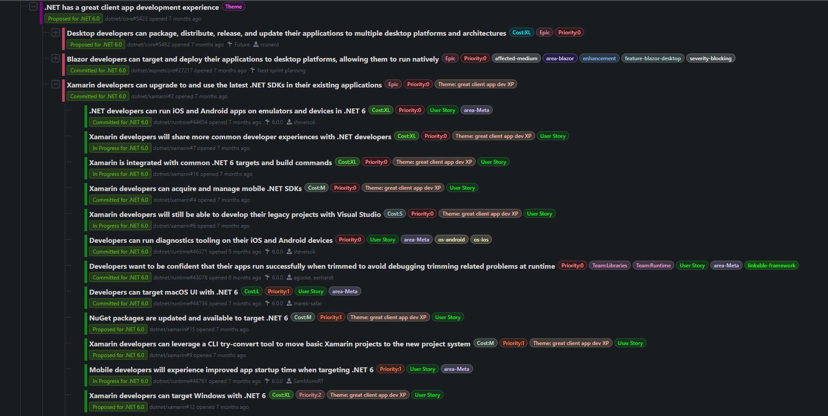
Follow our progress at themesof.net

Slide 19

Thanks for joining!
Maddy Leger| Program Manager | Microsoft
@maddyleger1 | maddy@microsoft.com
DotNet 2021 | theurlist.com/maui-dotnetspain

Slide 20
How is this native?
.NET Multi-platform App UI
.NET for Android
.NET for iOS / Mac Catalyst
WinUI
.NET BCL
App Code
.NET Runtime (Mono or CoreCLR)
Android
iOS
macOS
Windows

Slide 21
Native UI
Elements are realized via platform handlers.
 | ContentPage | Label | Picker
Android | Activity / Fragment | TextView | AlertDialog + LinearLayout + EditText + NumberPicker
iOS/Mac | UIViewController | UILabel | UITextField + UIPickerView + UIToolbar + UIBarButtonItem
WinUI | Page | TextBlock | ComboBox

